Slide 1



Towards Secure Layer-2 Blockchain Solutions Using TEEs
ESRGv3
Vitor Ribeiro
Advisor: Sandro Pinto PhD
Co-Advisor: David Cerdeira
Universidade do Minho
Nov, 2021
Notes:
1

Slide 2
Contextualization

Slide 3

Blockchain
“...”
Technology that allows recording digital information that can't be changed, hacked or cheated.
ESRGv3
3
Notes:
Fazer transições, 1 ponto de cada vez, para nãao ser excesso de informação
3

Slide 4
Blockchain
“...”
Technology that allows recording digital information that can't be changed, hacked or cheated.
Transactions are duplicated and distributed across the entire network of computers on the blockchain.
ESRGv3
4
Notes:
Fazer transições, 1 ponto de cada vez, para nãao ser excesso de informação
4

Slide 5
Blockchain
“...”
Technology that allows recording digital information that can't be changed, hacked or cheated.
Transactions are duplicated and distributed across the entire network of computers on the blockchain.
Nowadays, Blockchain is often associated to cryptocurrency, because is the core technology behind, Bitcoin and Ethereum.
ESRGv3
5
Notes:
Fazer transições, 1 ponto de cada vez, para nãao ser excesso de informação
5

Slide 6

Blockchain
“...”
Technology that allows recording digital information that can't be changed, hacked or cheated.
Transactions are duplicated and distributed across the entire network of computers on the blockchain.
Nowadays, Blockchain is often associated to cryptocurrency, because is the core technology behind, Bitcoin and Ethereum.
ESRGv3
6
Notes:
Fazer transições, 1 ponto de cada vez, para nãao ser excesso de informação
6

Slide 7



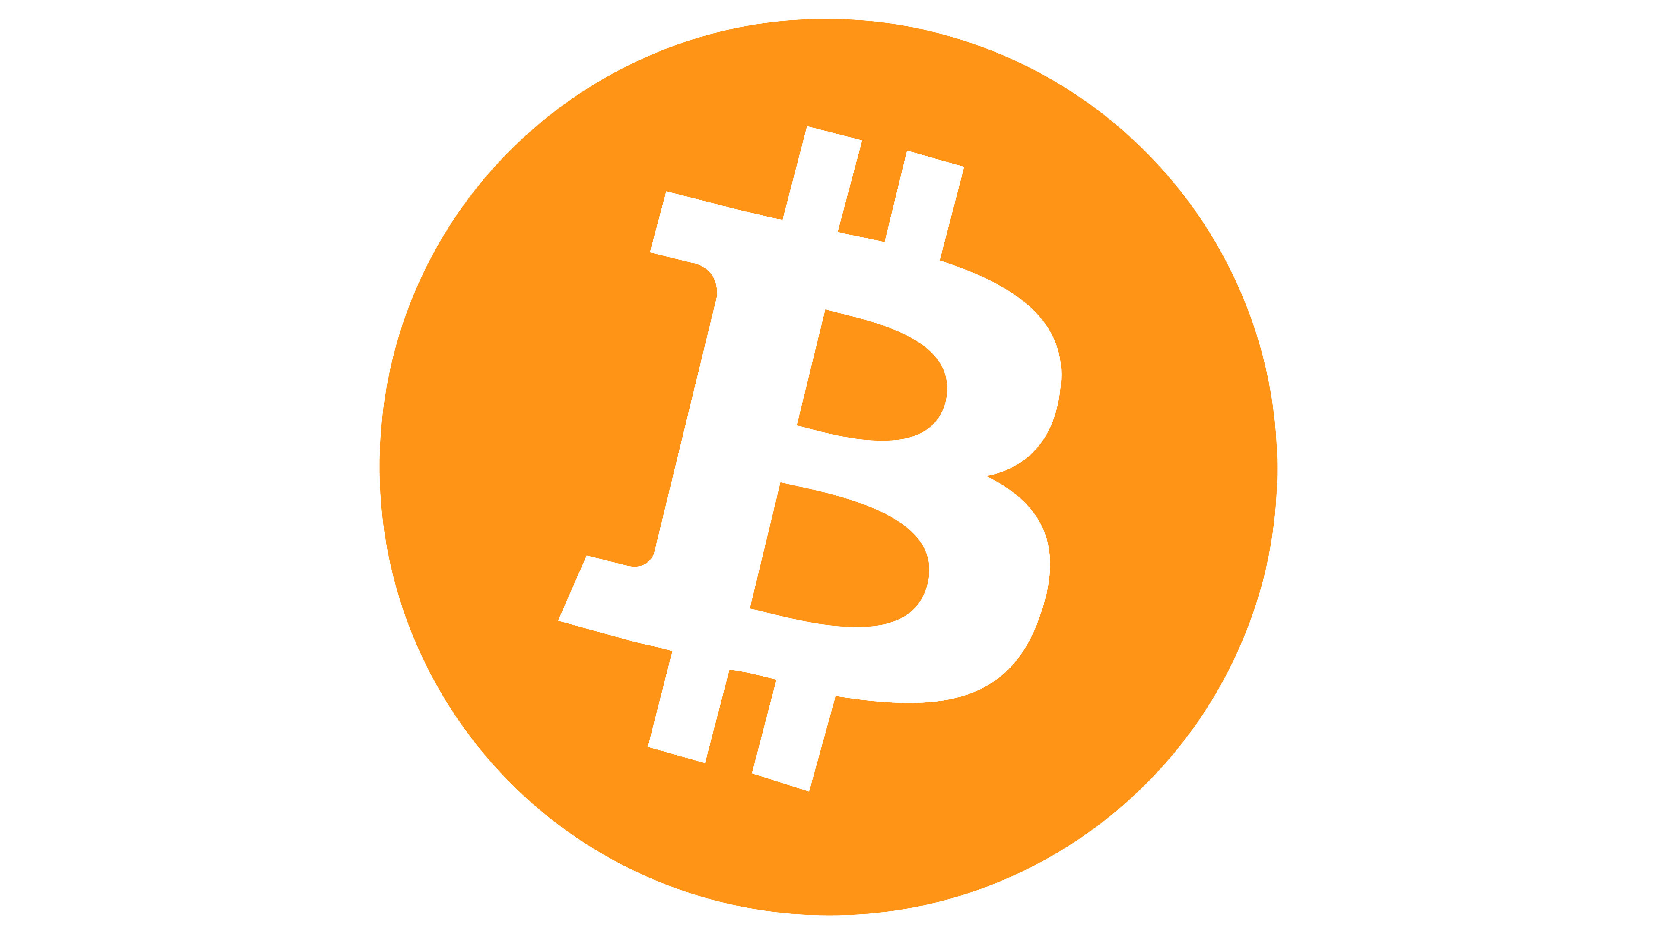

Blockchain – Vulnerabilities
Blockchain industry is not very mature when it comes to vulnerabilities and weaknesses.
ESRGv3
Notes:
Associar com segurança da blockchain (roubo de carteiras?? Vulnerabilidades?)
6

Slide 8
Blockchain – Vulnerabilities
Blockchain industry is not very mature when it comes to vulnerabilities and weaknesses.
Weaknesses are introduced into software (web services, smart contracts,DApps,...)
ESRGv3
Notes:
Associar com segurança da blockchain (roubo de carteiras?? Vulnerabilidades?)
7

Slide 9
Blockchain – Vulnerabilities
Blockchain industry is not very mature when it comes to vulnerabilities and weaknesses.
Weaknesses are introduced into software (web services, smart contracts,DApps,...)
Results in vulnerabilities:
Logic bugs
Integer overflows
Reentrancy issues
ESRGv3
Notes:
Associar com segurança da blockchain (roubo de carteiras?? Vulnerabilidades?)
8

Slide 10
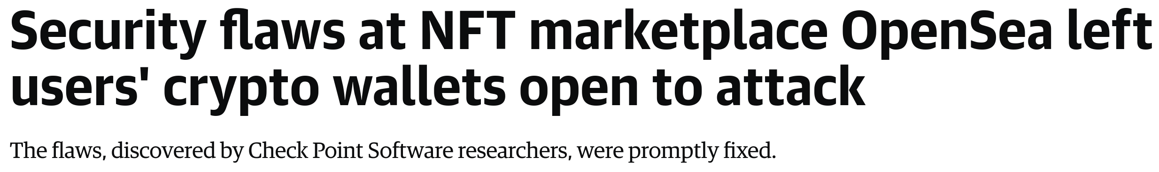
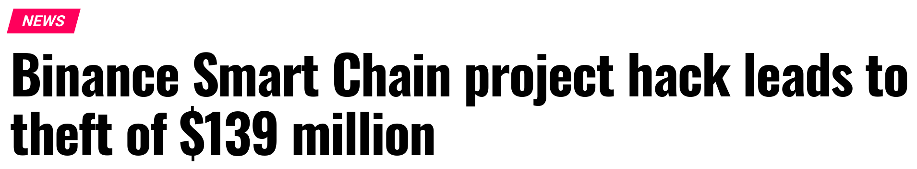
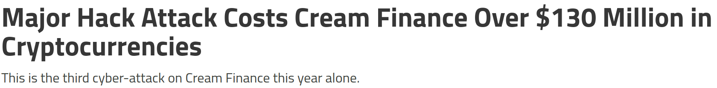
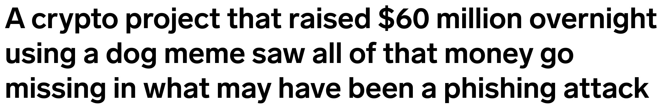
Blockchain – Vulnerabilities
Blockchain industry is not very mature when it comes to vulnerabilities and weaknesses.
Weaknesses are introduced into software (web services, smart contracts,DApps,...)
Results in vulnerabilities:
Logic bugs
Integer overflows
Reentrancy issues
ESRGv3
Notes:
Associar com segurança da blockchain (roubo de carteiras?? Vulnerabilidades?)
9

Slide 11

Trusted Execution Environment (TEE)
Isolated environment for executing code, in which those executing the code can have high levels of trust
ESRGv3
11
Notes:
TEEs ajudam a resolver estes problemas de segurança, vamos usar para tentar resolver problemas da blockchain
Resiste a ataques de fora do tee
10

Slide 12
Trusted Execution Environment (TEE)
Isolated environment for executing code, in which those executing the code can have high levels of trust
Guarantees the authenticity and confidentiality of the code
ESRGv3
12
Notes:
TEEs ajudam a resolver estes problemas de segurança, vamos usar para tentar resolver problemas da blockchain
Resiste a ataques de fora do tee
11

Slide 13
Trusted Execution Environment (TEE)
Isolated environment for executing code, in which those executing the code can have high levels of trust
Guarantees the authenticity and confidentiality of the code
Resists software attacks
ESRGv3
13
Notes:
TEEs ajudam a resolver estes problemas de segurança, vamos usar para tentar resolver problemas da blockchain
Resiste a ataques de fora do tee
12

Slide 14
Trusted Execution Environment (TEE)
Isolated environment for executing code, in which those executing the code can have high levels of trust
Guarantees the authenticity and confidentiality of the code
Resists software attacks
We will study how TEE can improve Blockchain security problems
ESRGv3
14
Notes:
TEEs ajudam a resolver estes problemas de segurança, vamos usar para tentar resolver problemas da blockchain
Resiste a ataques de fora do tee
13

Slide 15
Motivation

Slide 16
Motivation
Work with Blockchain Technology
Work with Linux
Work in Security Analysis
Work in open-source projects
Work with TEEs
Work in upcoming platforms
- RISC-V Architecture -
ESRGv3
16
Notes:
1 frase pequena para cada ponto
15

Slide 17
Goals

Slide 18
Goals
Create a threat model for a Blockchain solution (Cartesi)
ESRGv3
18
Notes:
17

Slide 19
Goals
Create a threat model for a Blockchain solution (Cartesi)
Threat Analysis
ESRGv3
19
Notes:
18

Slide 20
Goals
Create a threat model for a Blockchain solution (Cartesi)
Threat Analysis
Threat mitigation using TEEs
ESRGv3
20
Notes:
19

Slide 21
Technical & Scientific Relevance

Slide 22
Technical & Scientific Relevance
Blockchain is a recent and disruptive technology, gaining a lot of adoption
Immutability​
Transparency​
Security
ESRGv3
22
Notes:
Achamos que os tees dão para resolver
21

Slide 23
Technical & Scientific Relevance
Blockchain is a recent and disruptive technology, gaining a lot of adoption
Immutability​
Transparency​
Security
Blockchain Technology are not yet adopting TEEs as security method
Although it is secure, transparency brings some problems
ESRGv3
23
Notes:
Achamos que os tees dão para resolver
22

Slide 24
"Simplicity is the ultimate sophistication" - Leonardo da Vinci
THANK YOU!
| Vitor Ribeiro a86619 |
Notes:
23

